Slide 1


CPCA – NTN Strategic Partnership
Carl Swander, Ph.D. – President/CEO
Tony Percich – Vice President
Joe De Ladurantey – Retired Police Chief - Senior Field Consultant

Slide 2
NTN Company Profile
Experience
36 Years Public Safety Test Development and Administration
Over 2,000 Total Clients
100+ National Testing Centers
Professional Services - Promotional, Background Investigations, and Systems Integration
Award Winning Simulation Exams
Staff
Industrial/Organizational Psychologists
Public Safety Professionals
Dedicated Client Relations Team
Professional Proctor Teams
Trained Operations / Reporting Staff
Strong / Effective Executive Leadership

Slide 3
Strategic Partnership
CPCA - NTN strategic partnership that can deliver value to member departments
More effective testing and recruiting tools
Increase candidate quality
Increase candidate diversity
cost savings
Increase Association revenue through state wide candidate testing

Slide 4
QUALITY
Positively impact the QUALITY of personnel at all levels within public safety departments
Hiring quality candidates requires the right tools and the right candidates

Slide 5
Current Recruitment Challenges
Less available candidates
4.3% National unemployment rate
10% in 2009
4.7% California unemployment rate
12+% in 2009
Negative public safety job perception

Slide 6
Current Recruitment Challenges
Increasing demand on officer job performance
Increased attention leads to more situations of a difficult nature
Common sense, judgement, decision making are all needed when engaging with public in difficult situations
How can we have higher standards with fewer candidates?

Slide 7
Candidate Numbers
What can we impact?
Economy - No
Negative Media Coverage - No
Recruitment – Yes
Candidate Convenience – Yes
More testing options
Easier to get information to a department
Toll free candidate support

Slide 8
Limitations to Success
Department Candidate Barriers
Budget challenges
Resource driven testing models
Minimal recruitment
Infrequent testing
Minimal candidate support
Barriers often lead department to lower standards to maintain candidate numbers (MQs, Cut Scores)

Slide 9
Remove Barriers
Increased recruitment
Provide a candidate centric model
More frequent and convenient test times
Dedicated candidate support
Access to hundreds of departments
Synergistic recruitment
How does NTN do this?
NTN’s centralized continuous recruitment and testing process

Slide 10
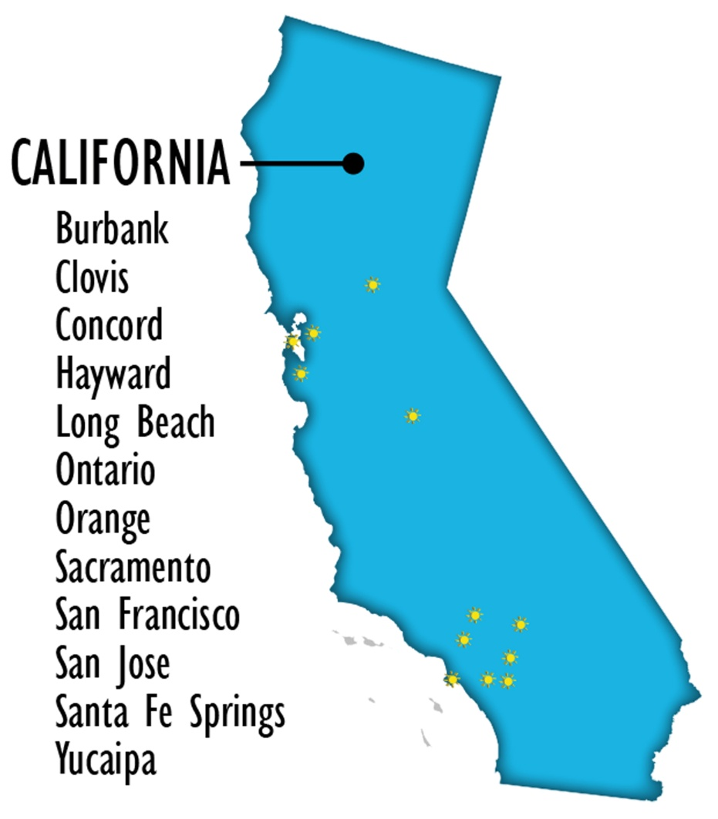
NTN California Testing
12 test center
Over 11,000 candidates tested in 2016
1,750 test sessions in 2016
Partner expansion in 2018 – over 115 statewide
Candidate capacity is unlimited

Slide 11
National Testing Network
100+ test centers
Hosted over 20,000 test sessions in 2016
280,000+ candidates tested
500+ departments
30 states and Washington D.C.
2,200 additional test centers in 2018

Slide 12
Sampling NTN Clients - CA
City of Beverly Hills City of Burbank
City of Fremont City of Downey
City of Walnut Creek City of Huntington Beach
City of Long Beach City of Ontario
City of Rialto City of Palo Alto
City of San Francisco City of San Bernardino
City of Oakland City of Santa Barbara
City of San Jose City of Torrance
City of South Pasadena City/County Santa Clara
City of Vacaville City of Palm Springs

Slide 13
NTN Metrics
 | Traditional | NTN
Candidate Show Rate - Average | 40-60% | 94.5%
Candidate Show Rate - SFPD | 50% | 94%
Candidate Volume - Average | Baseline | 2.5X
Candidate Volume SFPD | Baseline | 2.7X
Diversity Percentage - Average | Baseline | 2.75X
Diversity Percentage SFPD | Baseline | 2.5X
Candidate Satisfaction Rate | ?? | >80%
Cost | $10-300,000 | $500-2,500
Cost SFPD | $275,000 | $2,500

Slide 14
Shared Cost Model
Minimal Department Costs – Annual Memberships: $500 - $2500
Candidates Test Fees
Law: $49 candidate test fee, $9.50 to transfer a test score
Communications: $41 candidate test fee, $9.50 to transfer
Cost benefit model
Costs a candidate $88 to test for 5 departments….
How much could this cost?
gas, transportation, parking, time off, child care
Hardship program

Slide 15
Identify the Best
Assess minimum skills such as reading and writing (as required by POST)
Increase measurement of judgement and decision making
Use sophisticated tools, based on sound research, that predict overall job performance
FrontLine National Exam

Slide 16
CA POST Testing Requirements
Reg. 1951 - Peace Officer Reading and Writing Ability Assessment
(a) (1) Achievement of a score deemed acceptable by the hiring department on the POST Entry-Level Law Enforcement Test Battery or other professionally developed and validated test of reading and writing ability. The test can be administered by either the department or another entity.
FrontLine National includes a validated test of reading and writing ability.

Slide 17
FrontLine National Dimensions
Reading and Writing
Observation/Assessment/Critical Thinking Ability
Interrogation/Investigative Communication Ability
Team Orientation
Confrontation/Enforcement Initiative
Restraint in Use of Authority
Ethical Orientation
Ability to Understand and Help with Human Distress
Organizational Orientation
Customer/Community Relations Skills
NEW 2018: Integrity/Work Attitudes

Slide 18
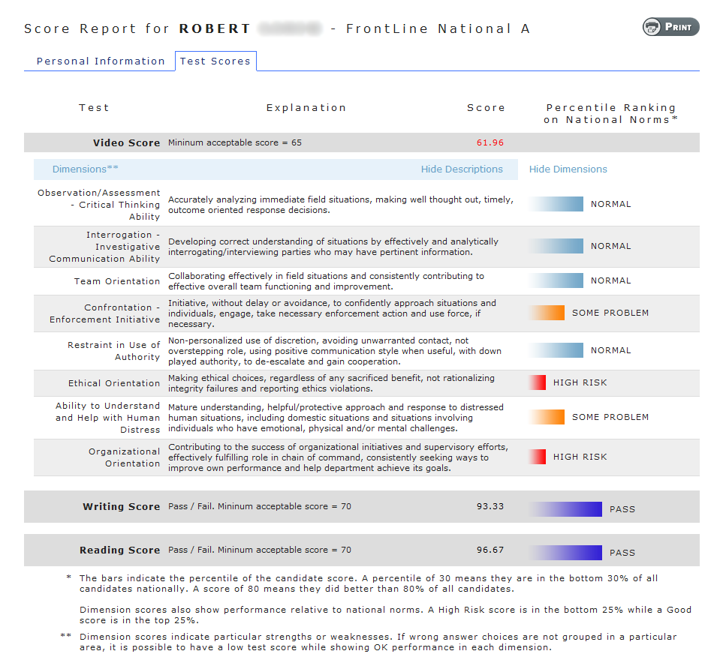

Slide 19
Sample Clients (>400)
City of San Francisco, CA
City of El Paso, TX
City of Long Beach, CA
City of Seattle, WA
City of Fort Lauderdale, FL
Michigan State Police
City of Las Vegas, NV
DC Metro, Dist. Columbia
City of Bellevue, WA
City of Portland, OR
City of Cleveland, OH
City of Aurora, CO
City of Denver, CO
City of Oakland, CA
City of San Jose, CA
City of Nashville, TN
City of Salt Lake, UT
City of Cincinnati, OH

Slide 20
FrontLine/NTN Results
Identify qualified and quality candidates
Increased pass rates for diverse candidates
No adverse impact
More defensible - criterion validated

Slide 21
Strategic Partnership
NTN can provide service and tools that enhance the quality of personnel at all levels for member departments
The value we provide to member departments will continue to grow as more departments
NTN aligns with the goals of the CPCA strategic partnership program

