Slide 1

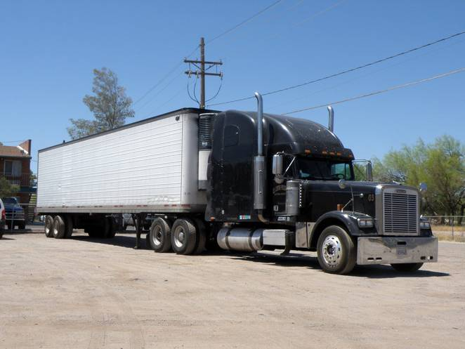
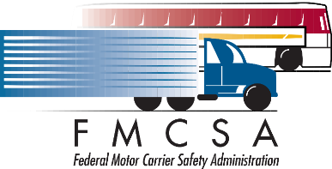
SAVE THE DATE!
LT&BTET Train-the-Trainer Course
FILL IN DATE
What? | The Large Truck & Bus Traffic Enforcement Training Program prepares in-state instructors to deliver a 2-hour in-service training program to ALL local officers and county sheriff deputies. The course teaches officers to engage large trucks and buses safely and effectively to reduce major crash injuries and fatalities.
Where? | San Diego County Sheriff's Department John F. Duffy Administrative Center - Rooms 3 & 4 9621 Ridgehaven Ct. San Diego, CA 92123
When? | Date: Monday, October 24, 2016: 8:00am to 12pm OR Tuesday, October 25, 2016: 8:00am to 12pm
What to wear? | Business casual or uniform equivalent. No shorts or sandals.
Who? | Instructors, sworn or non-sworn, and any other personnel who want to learn more about the LT&BTET program and its benefits.
How? | Register TODAY by contacting: Cpl. Todd Murphy, San Diego County Sheriff's Department todd.murphy@sdsheriff.org; Desk # 858-505-6596, OR Daniel Howard: danhoward@iadlest.org 609- 284-6019
Why? | Due to their size, large trucks and buses can wreak havoc on our nation’s highways when a crash occurs. Even though each state has designated officers focusing on traffic enforcement for this population, the number of crashes increases every year. We know that if local officers--to include city, county and other agencies--will actively enforce unsafe movement violations, then fatalities and crashes will diminish.

